Slide 1
Buffer Overflow Attack

Slide 2
Outline
Understanding of Stack Layout
Vulnerable code
Challenges in exploitation
Shellcode
Countermeasures

Slide 3
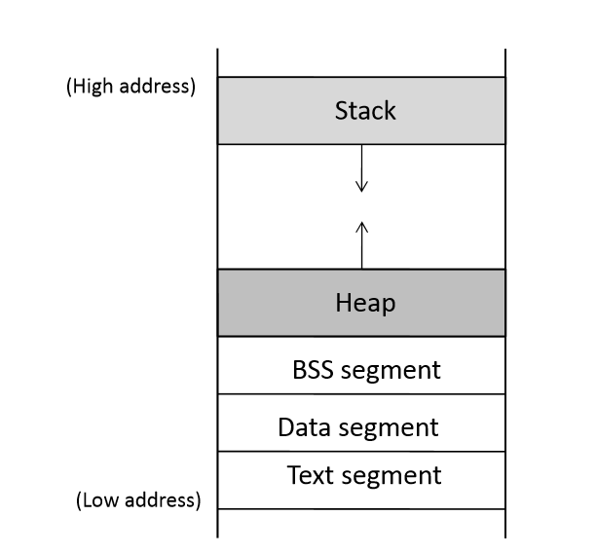
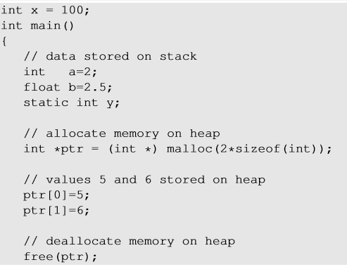

Program Memory Stack
a,b, ptr
ptr points to the memory here
y
x
Notes:
Global variables are stored in Data segment.
Uninitialized static variables are stored in BSS.
Dynamic memory is allocated in heap.
Local variables are stored in Stack.

Slide 4
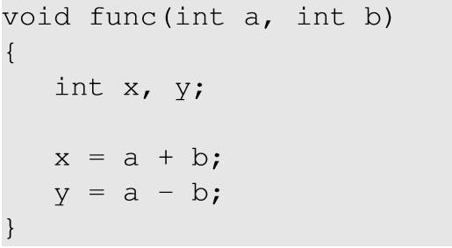
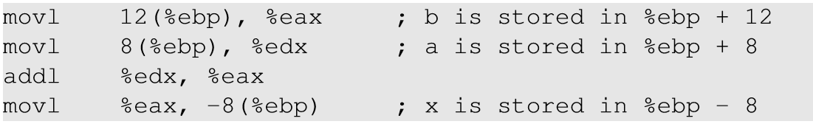
Order of the function arguments in stack
Notes:
The local variables and function arguments are stored in the stack with reference to ebp. The argument ‘b’ is stored at a higher address and hence is pushed into the stack before. The function arguments are pushed into the stack in reverse order.
Mane b er allocation ta sobar age hobe

Slide 5
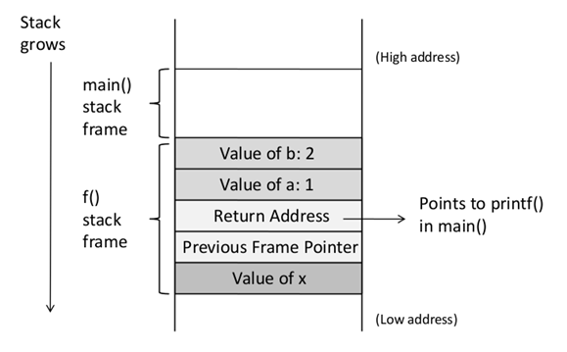
Function Call Stack
void f(int a, int b)
{
int x;
}
void main()
{
f(1,2);
printf("hello world");
}
Notes:
Main function calls f() with arguments a and b. f function stack frame is created below the main function stack. The returns address in the f() stack frame points to the next instruction address after the function is executed and returned. Here, it points to the printf() instruction.
2 ta important register holo base pointer ar stack pointer
Base pointer => currently jei function execute hocche tar stack frame er address

Slide 6
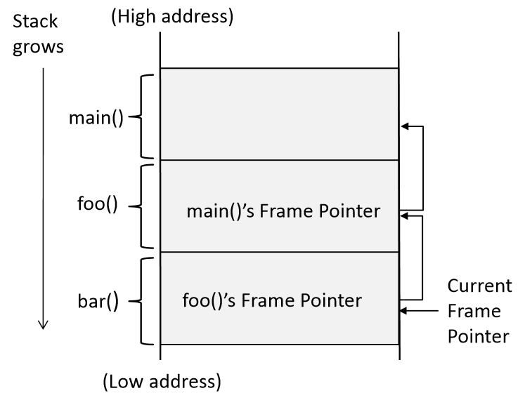
Stack Layout for Function Call Chain
main()
foo()
bar()
Notes:
The figure shows how functions are pushed into the stack. The return address in every function stack points to the next instruction that will be executed after the return. The frame pointer (ebp) of the caller function is stored in the callee’s function stack, so when the callee returns, the ebp register can point to the caller’s function stack.
Current frame pointer ta thakbe ebp er moddhe. Current frame pointer dharon korbe je oke call korche tar frame pointer.

Slide 7
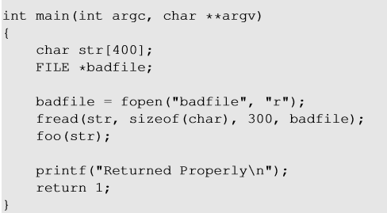
Vulnerable Program
Reading 300 bytes of data from badfile.
Storing the file contents into a str variable of size 400 bytes.
Calling foo function with str as an argument.
Note : Badfile is created by the user and hence the contents are in control of the user.

Slide 8
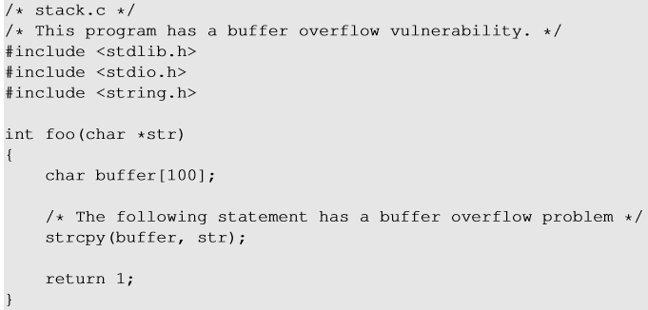
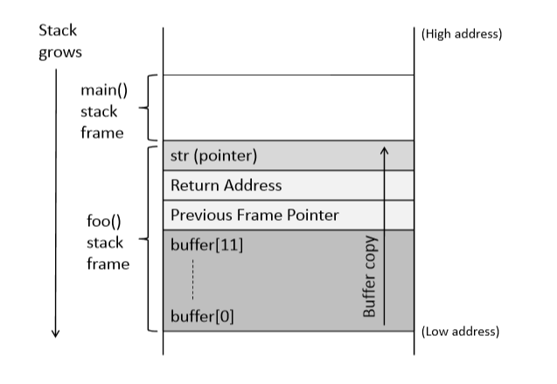
Vulnerable Program
Notes:
Here we are copying str (300 bytes of data) into a buffer of size 100 bytes. This leads to buffer overflow. As seen in the foo() stack frame, this overflow leads to overwriting of some of the important contents of the stack like frame pointer, return address etc.
str er size beshi holei problem
Strcpy null na pawa porjonto copy kortei thake
char buffer [] ke pointer er moto vabo. Eitar base er sathe amra jekono jinis jog kortei pari
Return address e amra amader malicious code er address diye dite chacchi.

Slide 9
Consequences of Buffer Overflow
Overwriting return address with some random address can point to :
Invalid instruction
Non-existing address
Access violation
Attacker’s code Malicious code to gain access

Slide 10
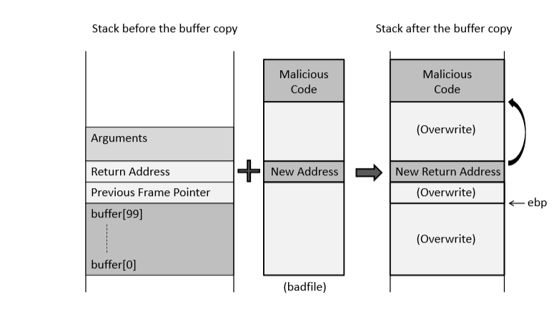
How to Run Malicious Code
Main code ta
Notes:
To run malicious code, we need to find a place in the function stack which will point to our code, jump to it and execute it. As we had seen that, when a function is executed it jumps to the return address (the instruction after the function was called in the caller function) , we can modify the return address with the address of the malicious code so that it jumps to the code and executes it.

Slide 11
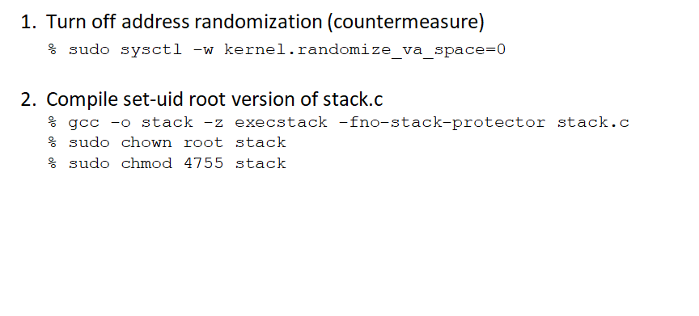
Environment Setup
Notes:
To perform this attack, we need to switch off the countermeasures which are discussed in the next slides.
Address randomization is turned off so that the base address of the buffer remains. It makes the task simpler to guess the return address in the stack.
We set the stack as executable as we need to execute our own code on the stack. Also, we disabled stack guard protection (discussed later).

Slide 12
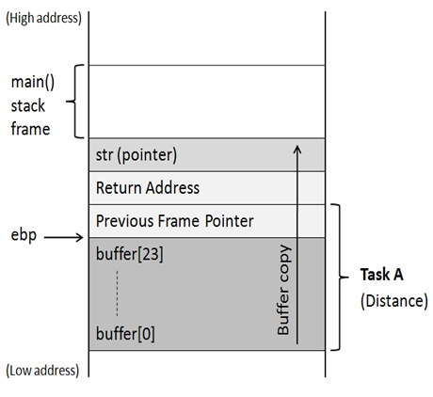
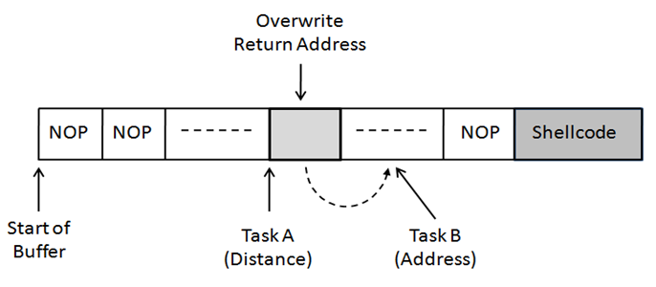
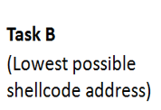
Creation of The Malicious Input (badfile)
Task A : Find the offset distance between the base of the buffer and return address.
Task B : Find the address to place the shellcode
Notes:
The two challenges faced when running the malicious code are :
Find the offset distance between the base of the buffer and return address so that we can modify the return with address of the code.
Find the address of the malicious code. If we don’t handle this, our malicious code will be stored in some random memory location to which we have control to. In that case we cannot modify the return address with the address of our code. Hence, we will put our malicious code in the function stack itself.
So,we need do the following on our badfile :
Write the malicious code (shellcode : discussed in later slides)
Place the malicious code in our stack ( At the lowest address above return address or at the end of the of the buffer)
Modify return address with address of the shell code

Slide 13
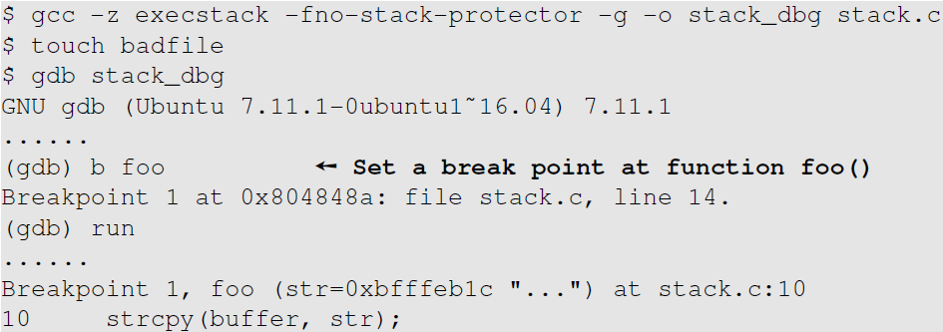
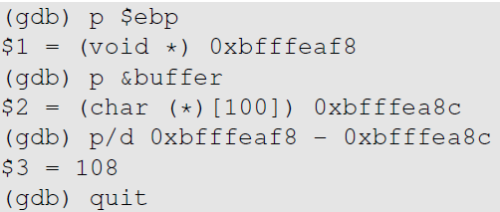
Task A : Distance Between Buffer Base Address and Return Address
Therefore, the distance is 108 + 4 = 112
Notes:
To find the distance between the base of the buffer and the return address, we need to use a gdb debugging tool. given that we have access to the vulnerable code, we can use gdb to the base address of the buffer, address of the frame pointer (ebp) and return address ($ebp + 4)

Slide 14
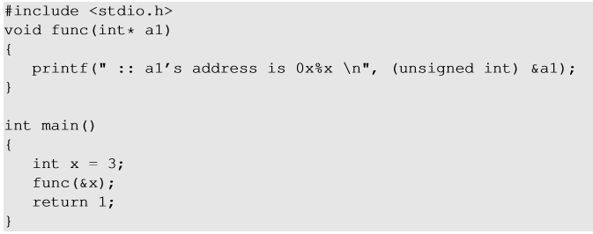
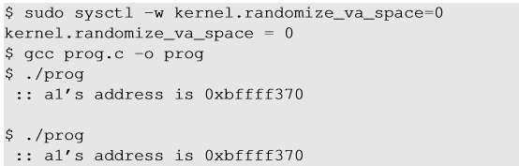
Task B : Address of Malicious Code
Investigation using gdb
Malicious code is written in the badfile which is passed as an argument to the vulnerable function.
Using gdb, we can find the address of the function argument.

Slide 15
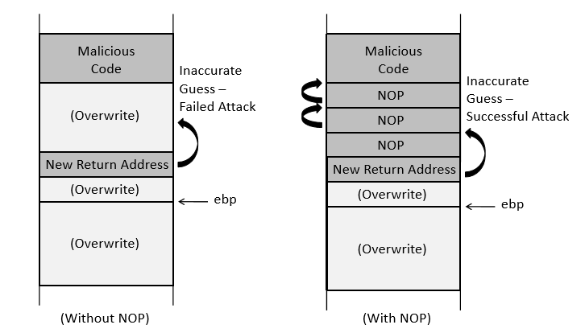
Task B : Address of Malicious Code
To increase the chances of jumping to the correct address, of the malicious code, we can fill the badfile with NOP instructions and place the malicious code at the end of the buffer.
Note : NOP- Instruction that does nothing.

Slide 16
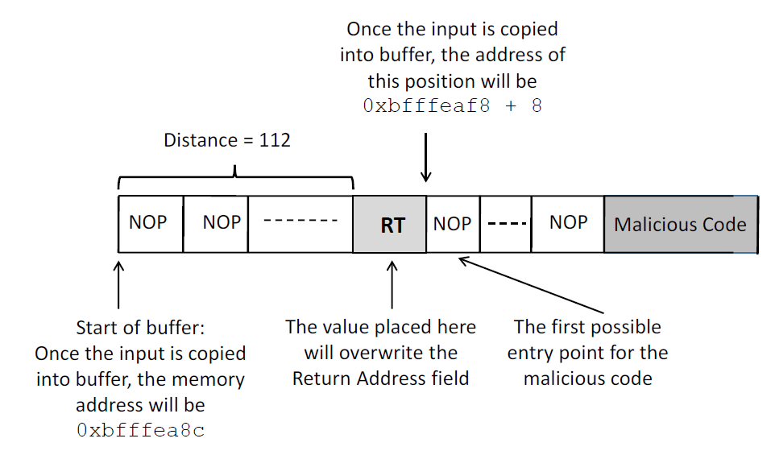
The Structure of badfile

Slide 17
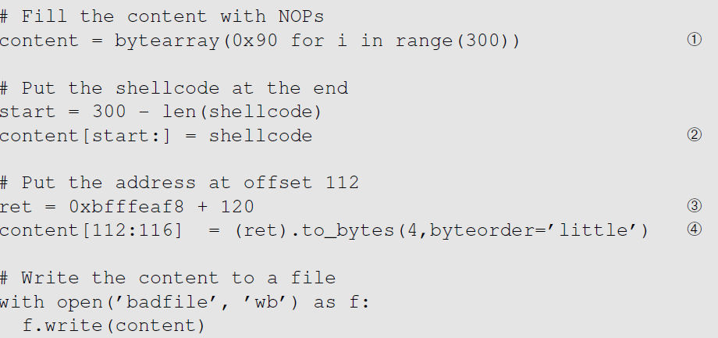
Badfile Construction
Notes:
- Initialize the entire buffer with NOP instructions.
- Obtain the results from Task A and Task B and place the malicious code address in return address.
- Place the malicious at the of the buffer.

Slide 18
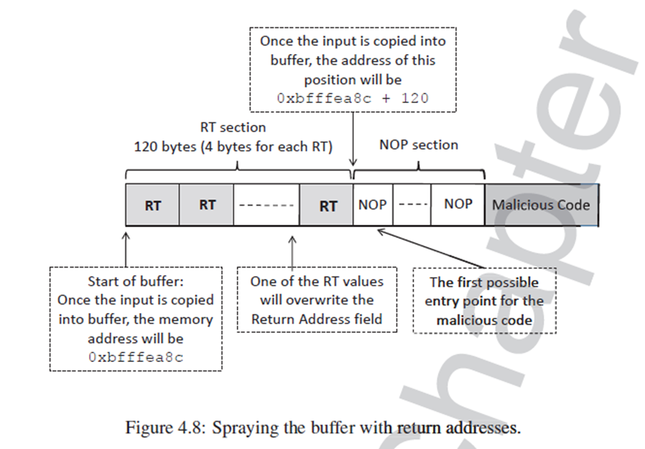
Attack With Unknown Buffer Size

Slide 19
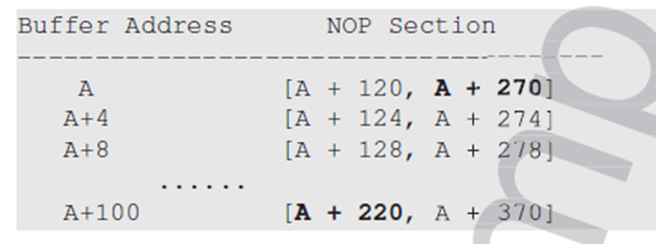
Attack With Unknown Buffer Address and Size

Slide 20
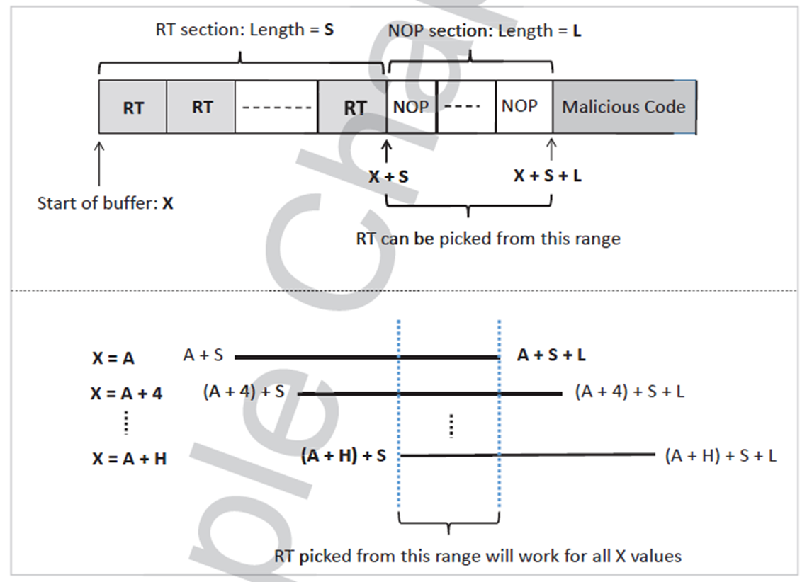
Attack With Unknown Buffer Address and Size

Slide 21
New Address in Return Address
Considerations :
The new address in the return address of function stack [0xbffff188 + nnn] should not contain zero in any of its byte, or the badfile will have a zero causing strcpy() to end copying.
e.g., 0xbffff188 + 0x78 = 0xbffff200, the last byte contains zero leading to end copy.

Slide 22
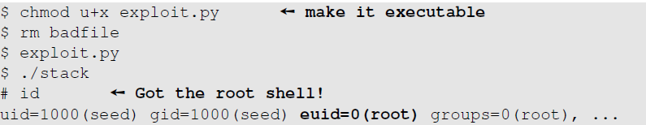
Execution Results
Compiling the vulnerable code with all the countermeasures disabled.
Executing the exploit code and stack code.

Slide 23
A Note on Countermeasure
On Ubuntu16.04, /bin/sh points to /bin/dash, which has a countermeasure
It drops privileges when being executed inside a setuid process
Point /bin/sh to another shell (simplify the attack)
Change the shellcode (defeat this countermeasure)
Other methods to defeat the countermeasure will be discussed later

Slide 24
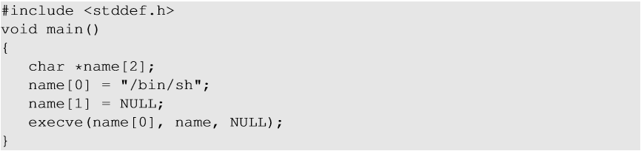
Shellcode
Aim of the malicious code : Allow to run more commands (i.e) to gain access of the system.
Solution : Shell Program
Challenges :
Loader Issue
Zeros in the code
Notes:
The above C code gives the shell prompt to execute more commands. We can compile the above C code into binary and store it into the badfile with modified return address field to the address of main(). But there are issues with this solution :
Loader Issue : OS loader is responsible for setting up the memory, copying the program to the memory and invoking dynamic linker to link libraries etc to set up the running environment of the program.After the initializations steps are completed, main() is called. If any of the steps are missing, program won’t be loaded to the memory. In buffer flow program, we are copying the code using memory copy. Therefore all the initialization steps are missing and hence, our shell code won’t be executed.
Zeros in the code : strcpy() stops copying when a zero is found in the source string. When the C code is compiled ot binary, there will be zeros in the binary code which will stop copying the badfile further.
Refer to section 4.6

Slide 25
Shelllcode
Assembly code (machine instructions) for launching a shell.
Goal: Use execve(“/bin/sh”, argv, 0) to run shell
Registers used:
eax = 0x0000000b (11) : Value of system call execve()
ebx = address to “/bin/sh”
ecx = address of the argument array.
argv[0] = the address of “/bin/sh”
argv[1] = 0 (i.e., no more arguments)
edx = zero (no environment variables are passed).
int 0x80: invoke execve()

Slide 26
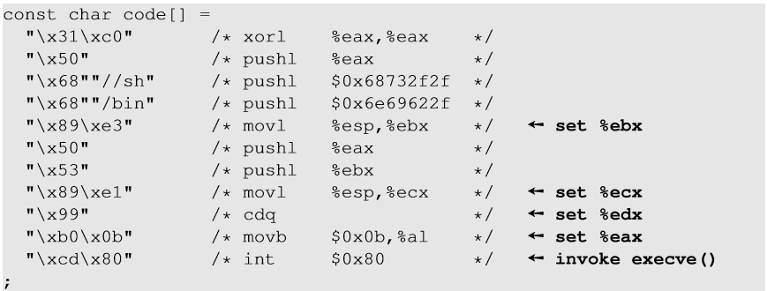
Shellcode
%eax = 0 (avoid 0 in code)
set end of string “/bin/sh”

Slide 27
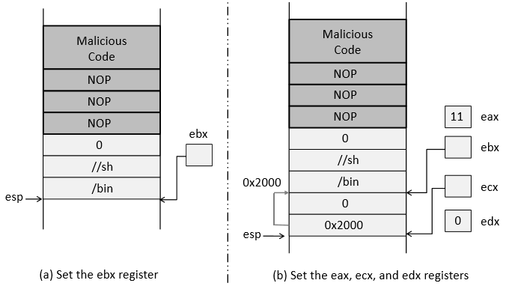
Shellcode
Notes:
Refer to section 4.6.2 and 4.6.3

Slide 28
Countermeasures
Developer approaches:
Use of safer functions like strncpy(), strncat() etc, safer dynamic link libraries that check the length of the data before copying.
OS approaches:
ASLR (Address Space Layout Randomization)
Compiler approaches:
Stack-Guard
Hardware approaches:
Non-Executable Stack

Slide 29
Principle of ASLR
To randomize the start location of the stack that is every time the code is loaded in the memory, the stack address changes.
Difficult to guess the stack address in the memory.
Difficult to guess %ebp address and address of the malicious code

Slide 30
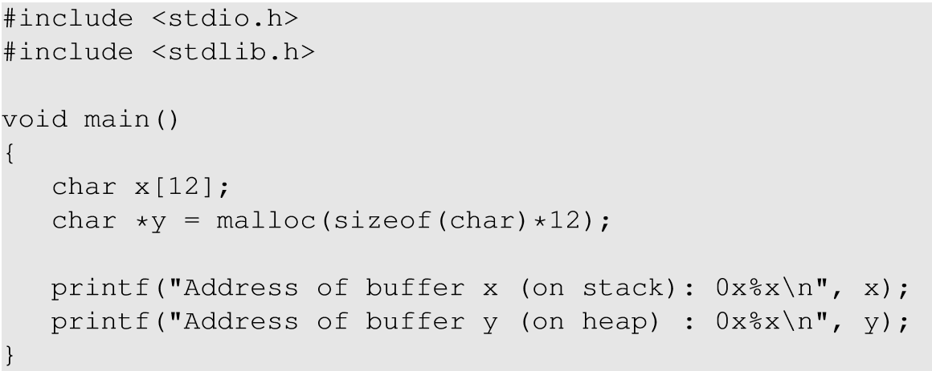
Address Space Layout Randomization
Notes:
When the ASLR is enabled in the Linux machine, we ran the above code to check how it affects the addresses of the local variables on stack as well as heap. ASLR changes the address of the code every time it is loaded.

Slide 31
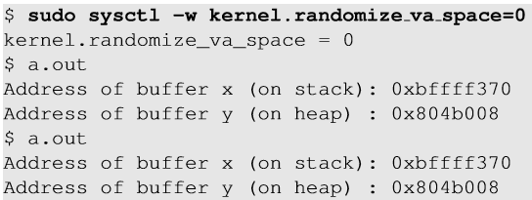
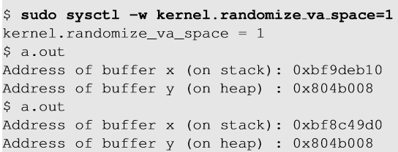
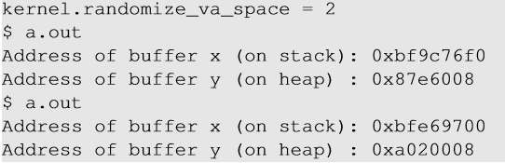
Address Space Layout Randomization : Working
1
2
3
Notes:
1 : When set to 0, the address space is not randomized.
2 : When set to 1, only stack memory address is randomized.
3 : When set to 2, both stack and heap memory address is randomized.

Slide 32
ASLR : Defeat It
Turn on address randomization (countermeasure)
% sudo sysctl -w kernel.randomize_va_space=2
2. Compile set-uid root version of stack.c
% gcc -o stack -z execstack -fno-stack-protector stack.c
% sudo chown root stack
% sudo chmod 4755 stack

Slide 33
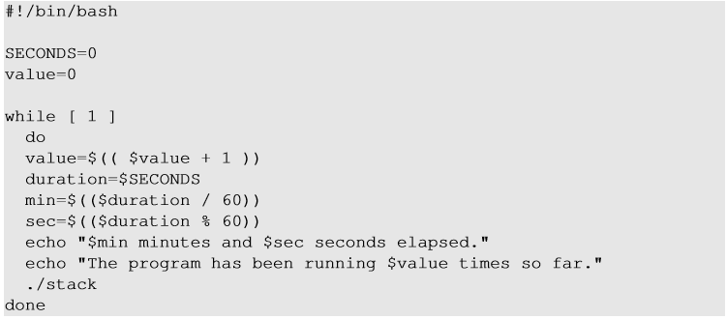
ASLR : Defeat It
3. Defeat it by running the vulnerable code in an infinite loop.

Slide 34
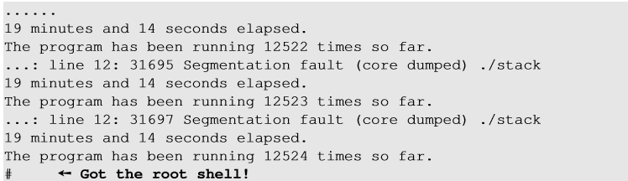
ASLR : Defeat it
On running the script for about 19 minutes on a 32-bit Linux machine, we got the access to the shell (malicious code got executed).

Slide 35
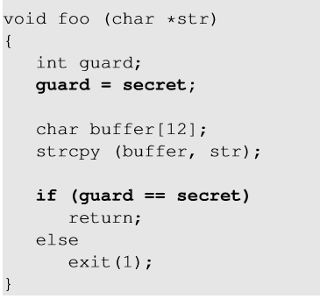
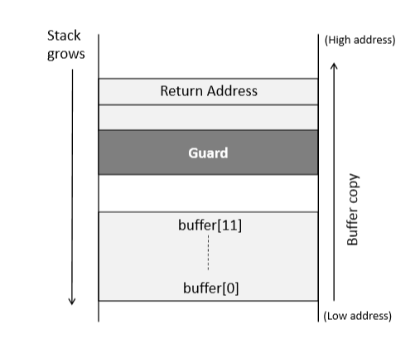
Stack guard
Notes:
Stackguard is a compiler approach to defeat buffer overflow. A random secret value is generated and stored in a memory location (not on stack) and is assigned to a local variable of the function which gets stored in the stack. After the copy function is function, it is checked if the value of the local variable is changed. If yes, buffer overflow has taken place and the program exits without returning.

Slide 36
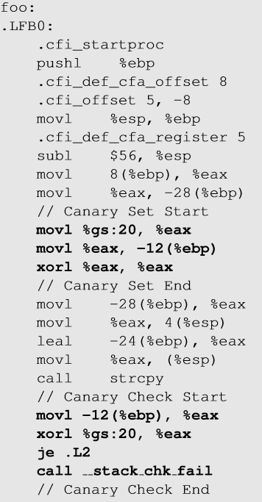
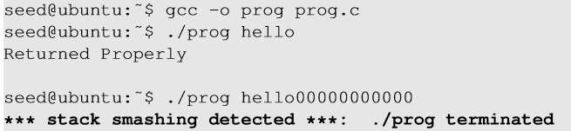
Execution with StackGuard
Canary check done by compiler.
Notes:
Prog.c is a vulnerable program which takes input from the user and calls a function foo() which copies to a buffer. When the user passes a variable of longer length than buffer size, it changes the value of the local variable (guard) and hence, the program terminates with stack smashing message.

Slide 37
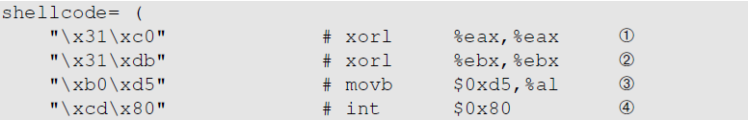
Defeating Countermeasures in bash & dash
They turn the setuid process into a non-setuid process
They set the effective user ID to the real user ID, dropping the privilege
Idea: before running them, we set the real user ID to 0
Invoke setuid(0)
We can do this at the beginning of the shellcode

Slide 38
Non-executable stack
NX bit, standing for No-eXecute feature in CPU separates code from data which marks certain areas of the memory as non-executable.
This countermeasure can be defeated using a different technique called Return-to-libc attack (there is a separate chapter on this attack)

Slide 39
Summary
Buffer overflow is a common security flaw
We only focused on stack-based buffer overflow
Heap-based buffer overflow can also lead to code injection
Exploit buffer overflow to run injected code
Defend against the attack

